Slide 1
3D Flexible Refinement: Structure and Motion of Flexible Proteins from Cryo-EM
Szu-Chi Chung
Institute of Statistical Science, Academia Sinica

Slide 2
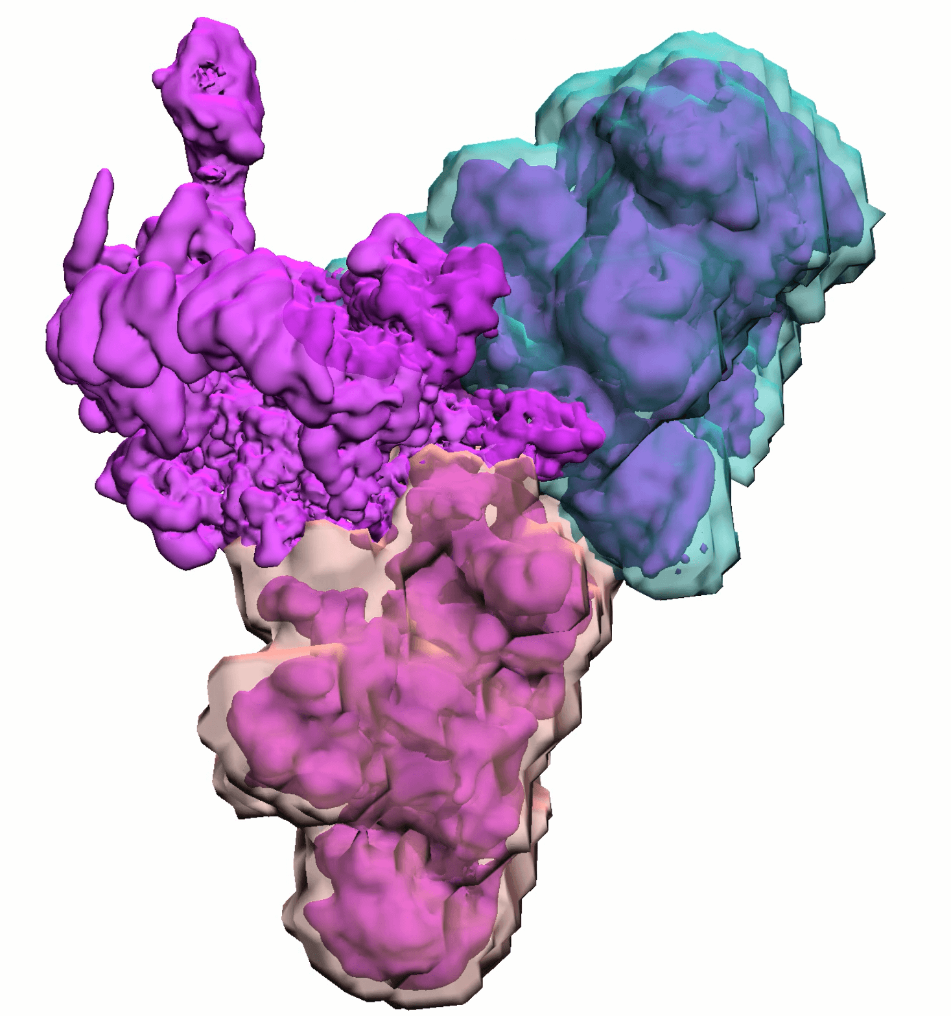
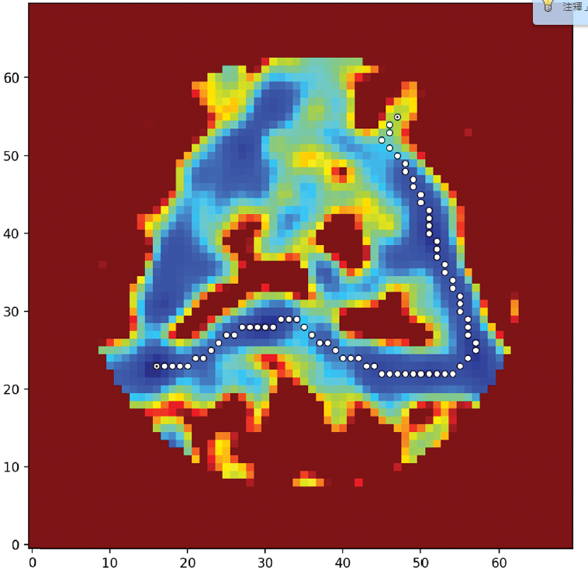
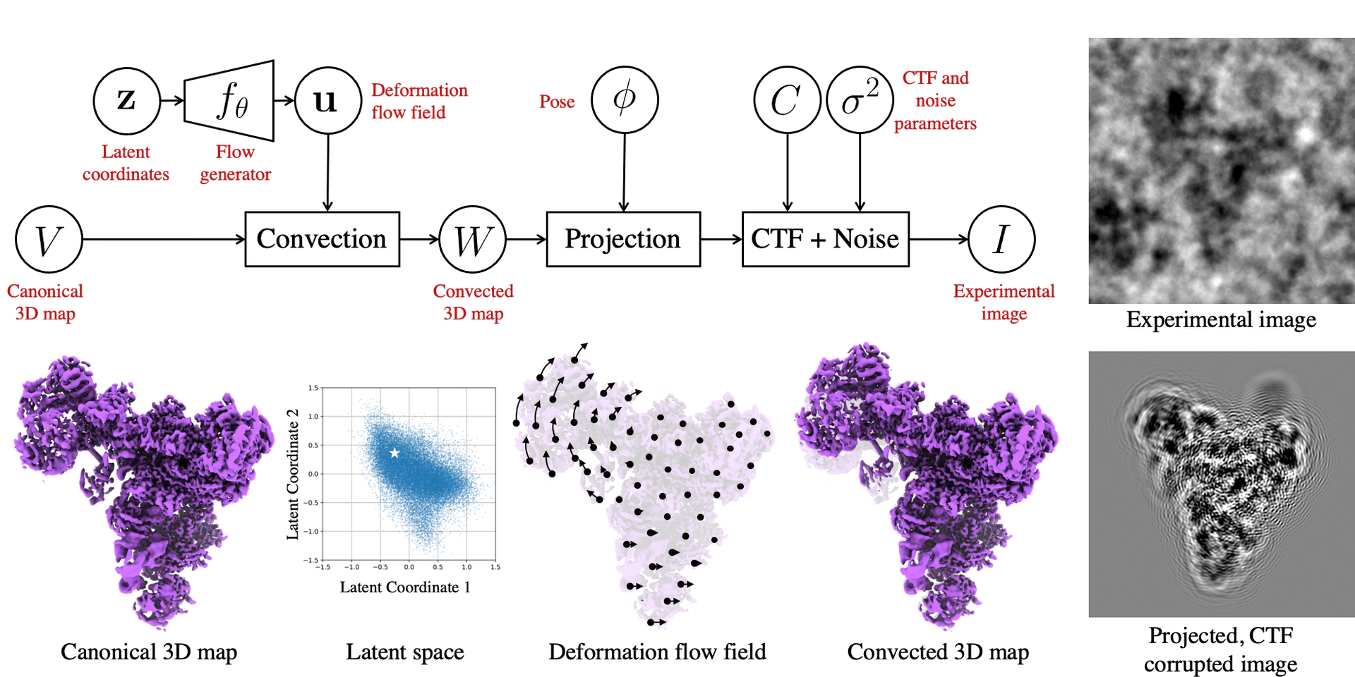
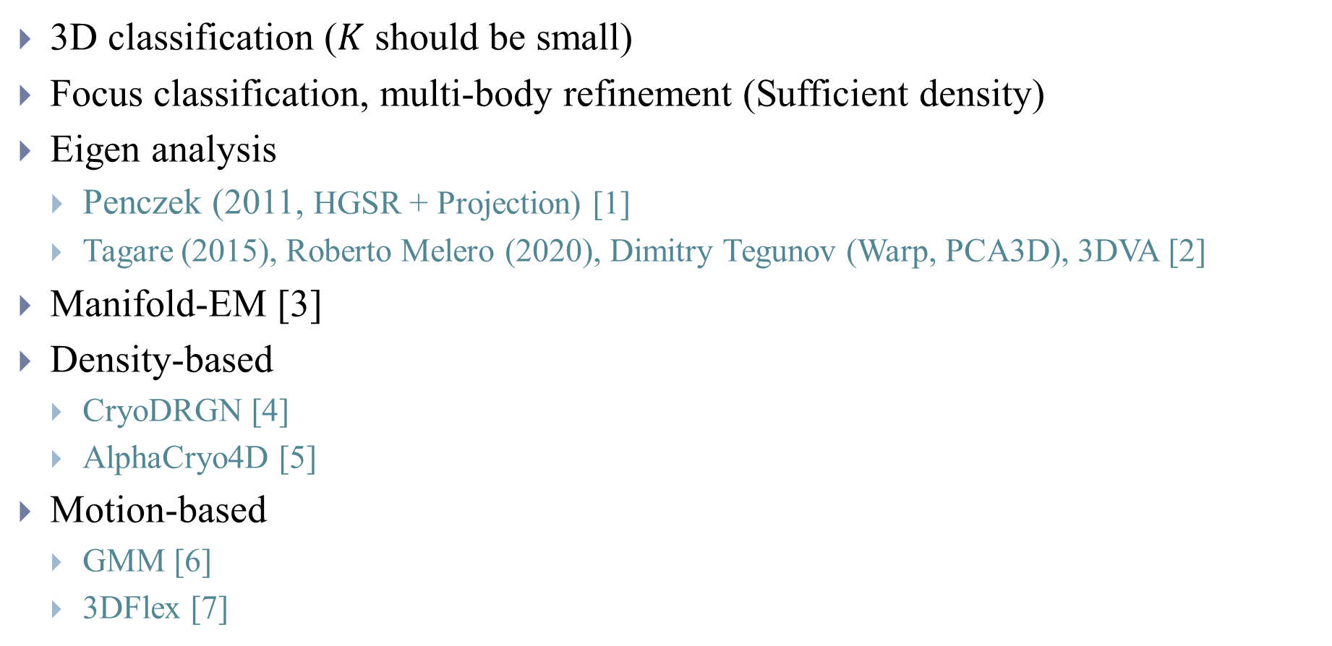
Existing approaches
3D classification ($K$ should be small)
Focus classification, multi-body refinement (Sufficient density)
Eigen analysis
Penczek (2011, HGSR + Projection) [1]
Tagare (2015), Roberto Melero (2020), Dimitry Tegunov (Warp, PCA3D), 3DVA [2]
Manifold-EM [3]
Density-based
CryoDRGN [4]
AlphaCryo4D [5]
Motion-based
GMM [6]
3DFlex [7]
Notes:
Multi-body -> 3D segmentation, prior knowledge, large enough

Slide 3
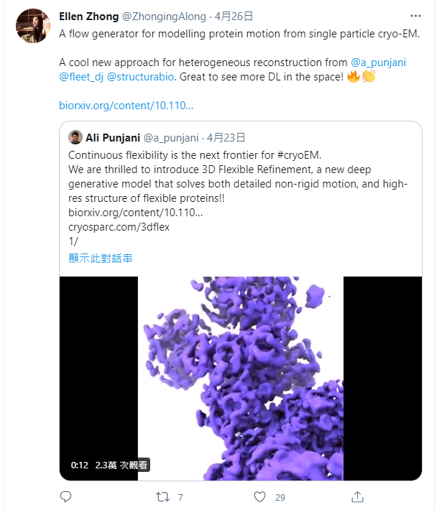
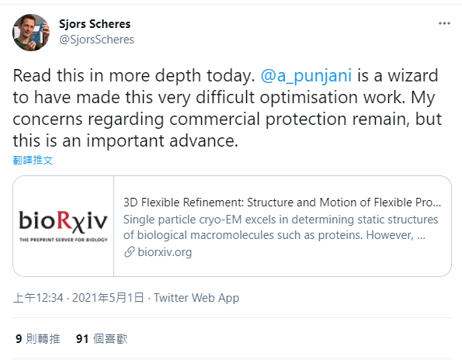

Slide 4
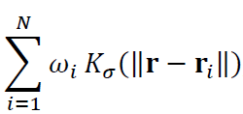
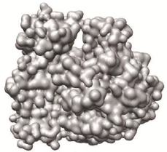
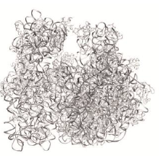
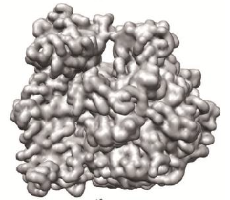
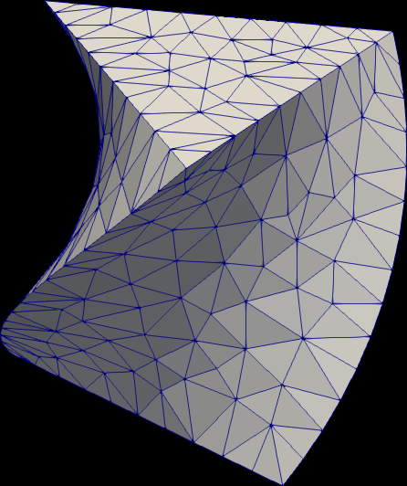
Motion-based methods
Confromation variability tends to conserve mass and preserve local geometry
Represent 3D density map as 3D Gaussian mixture model (five degrees of freedom)
3D coordinates, amplitude and width
Motion is represented by the location change of 3D coordinate
Represent 3D flow field as the vertices of tetrahedral mesh
The deformation field is parameterized by a 3D flow vector at each vertex of the tetrahedral mesh
Notes:
Second, at low resolution, Gaussian functions are a natural way to model the electron density function of molecules. If these methods were extended to atomic resolution representation,
it may be necessary to include the atomic form factors in the model, but at intermediate resolutions these subtleties are effectively undetectable.
The deformation field is then interpolated using linear FEM shape functions within each mesh element.
The shape function is the function which interpolates the solution between the discrete values obtained at the mesh nodes

Slide 5
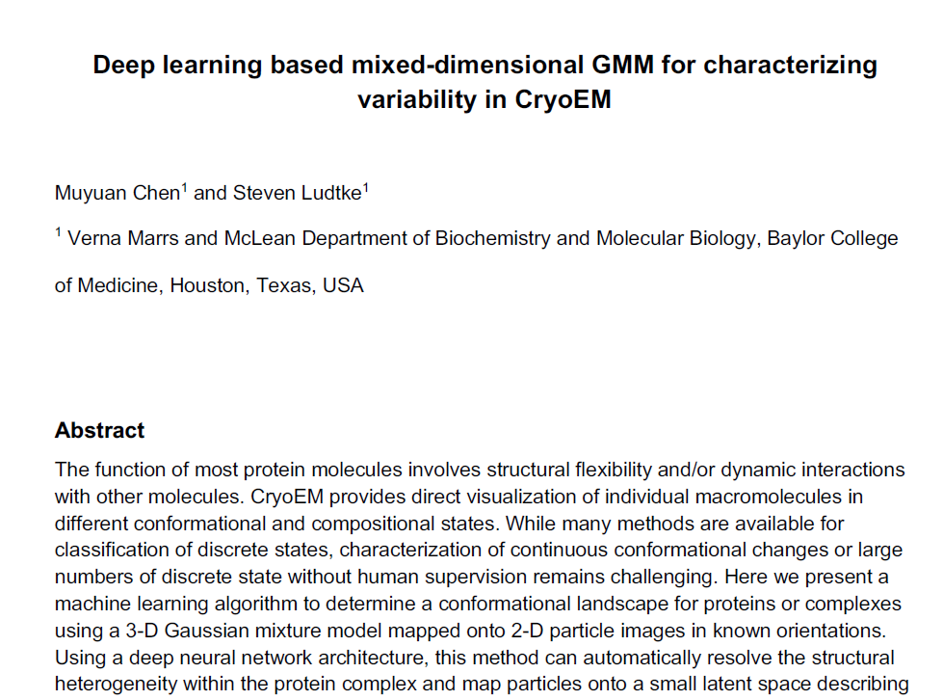
e2GMM
Analog to refine atomic structure against raw data
In reduced representation - the parameters of Gaussian is greatly reduced
Easier to represent ligand binding and domain motion compared to the voxel-based representation
Masking and projection can be performed but subset selection of Gaussian without interpolation
Notes:
84X84X84->2048X5 (protein occupy sparsely)

Slide 6
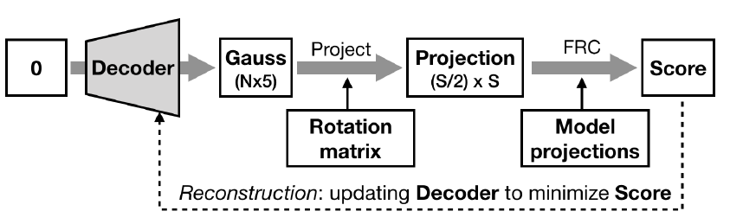
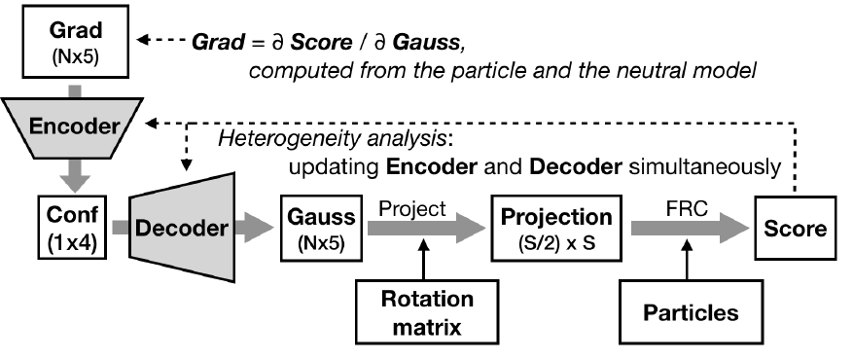
e2GMM (Gaussian mixture model)
First stage: Train the decoder to provide initial canonical density for 2D data
Train with downsampled version of the map
Increase the box size
Second stage: Jointly train the encoder and decoder with gradient vector
Each point correspond to a 3D structure
Fix
Consensus map
From refinement
Notes:
0 represent neutral configuration

Slide 7
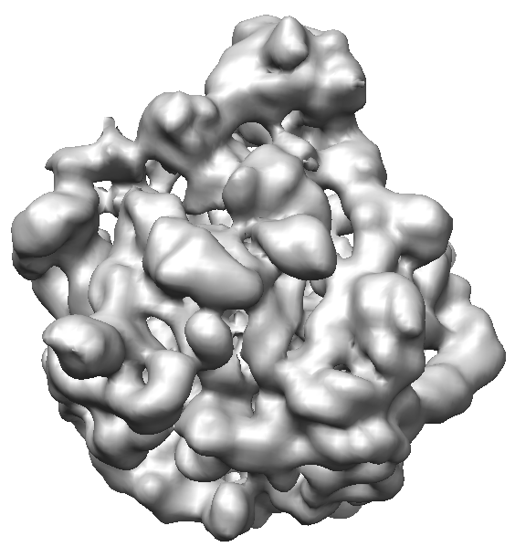
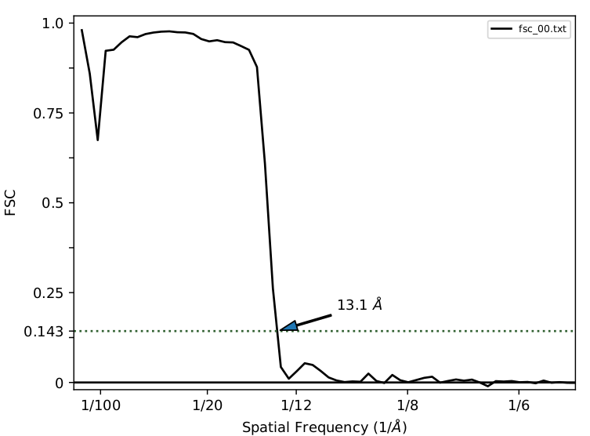
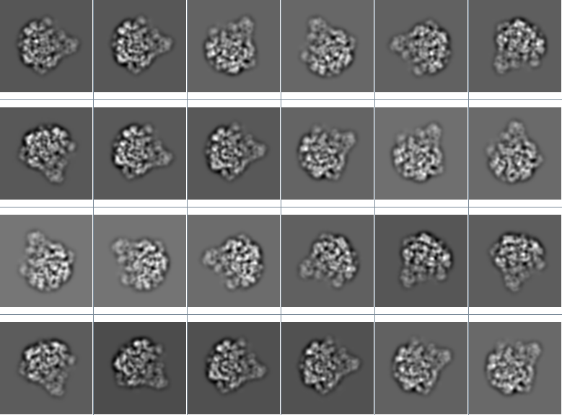
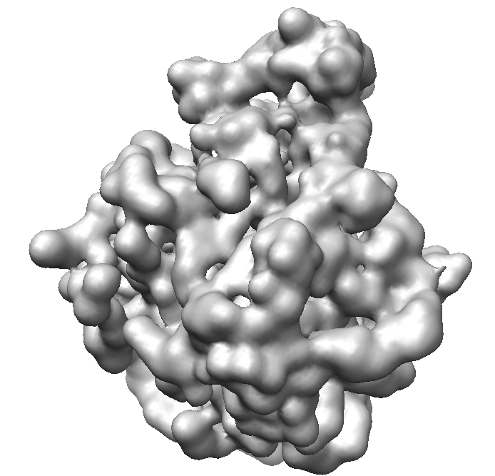
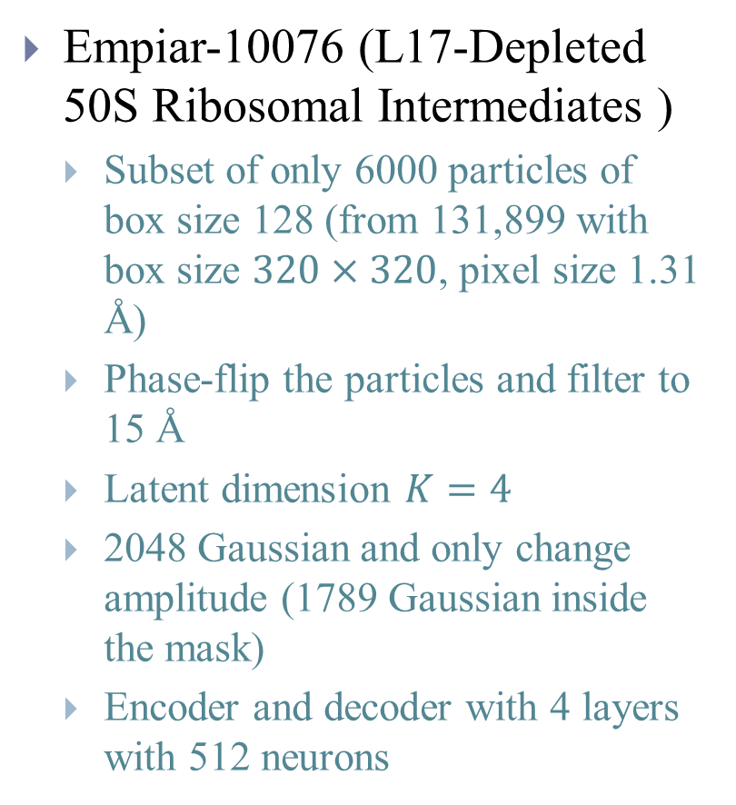
Bacterial Large Ribosomal Subunit
Concensus map
Empiar-10076 (L17-Depleted 50S Ribosomal Intermediates )
Subset of only 6000 particles of box size 128 (from 131,899 with box size $320×320$, pixel size 1.31 Å)
Phase-flip the particles and filter to 15 Å
Latent dimension $K=4$
2048 Gaussian and only change amplitude (1789 Gaussian inside the mask)
Encoder and decoder with 4 layers with 512 neurons
Canonical map
Notes:
3.275A
Central protuberance
Since most of the structural variabilities within this dataset are the presence/absence of individual ribosomal components, we initially permitted only the Gaussian
amplitudes to vary
Allgrad 6000x1789x5

Slide 8
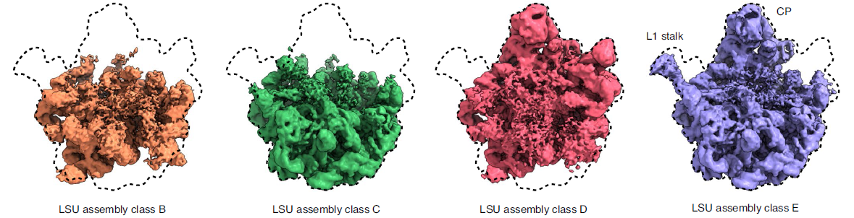
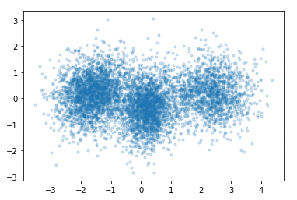
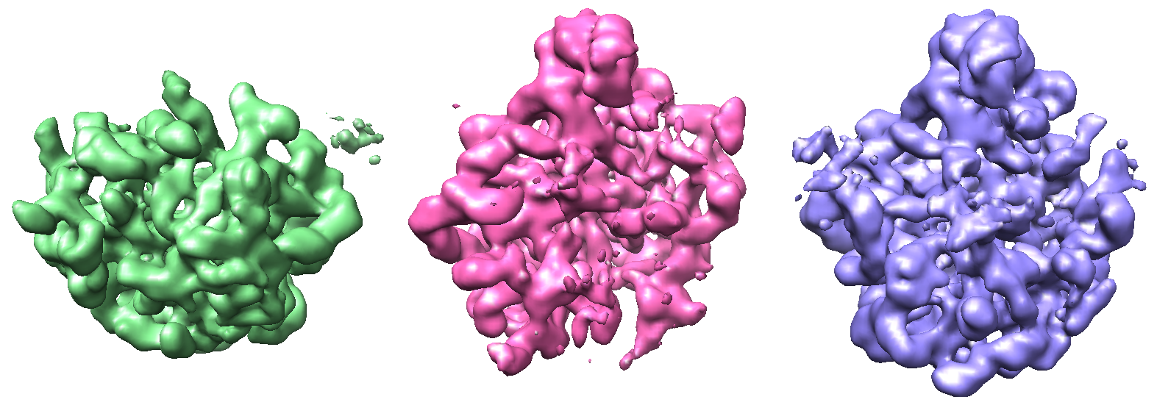
Bacterial Large Ribosomal Subunit
4D latent space
PC2
PC1

Slide 9
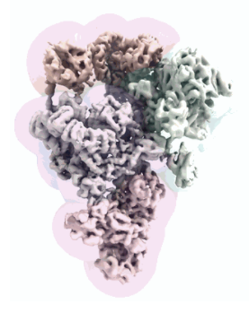
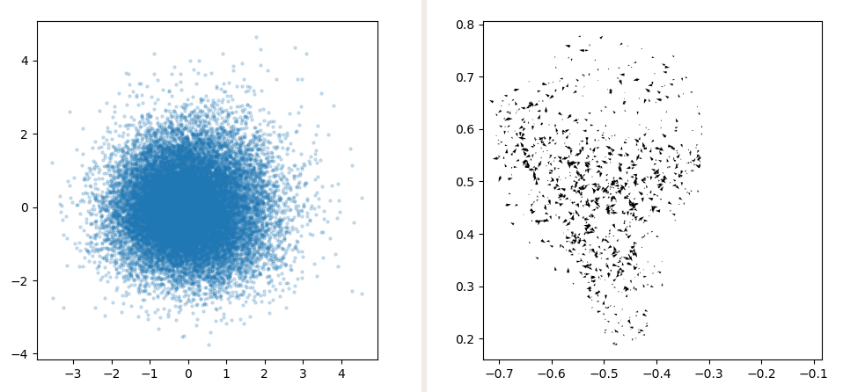
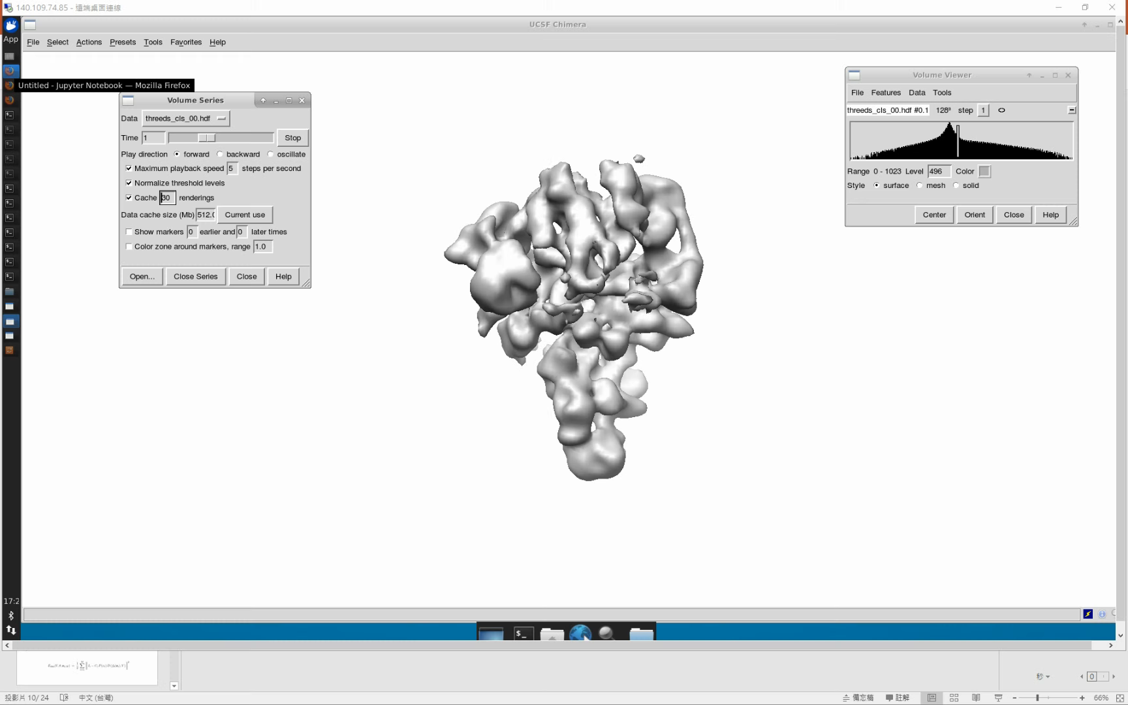
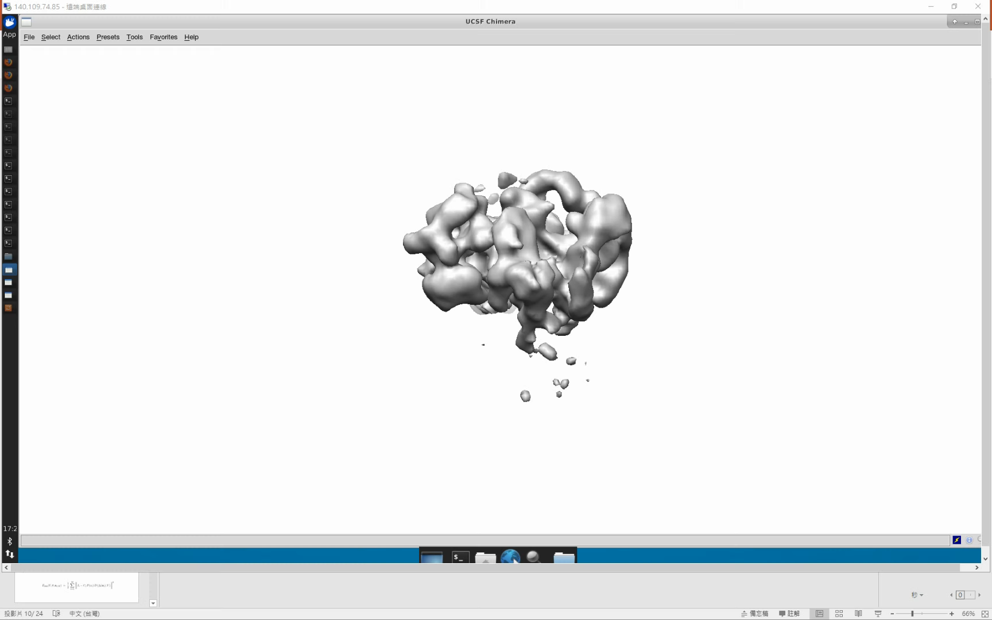
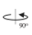
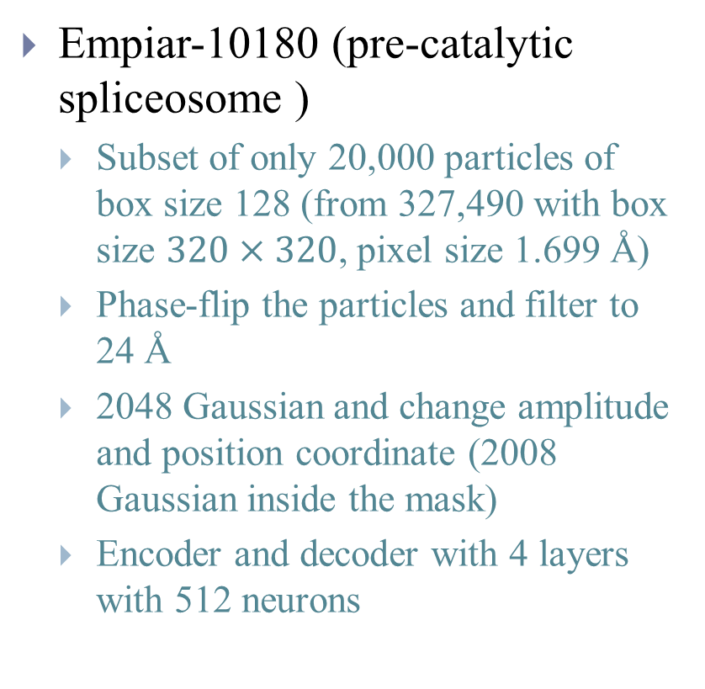
Spliceosome - Large flexible motions of large complexes
Empiar-10180 (pre-catalytic spliceosome )
Subset of only 20,000 particles of box size 128 (from 327,490 with box size $320×320$, pixel size 1.699 Å)
Phase-flip the particles and filter to 24 Å
2048 Gaussian and change amplitude and position coordinate (2008 Gaussian inside the mask)
Encoder and decoder with 4 layers with 512 neurons
PC2
PC1

Slide 10
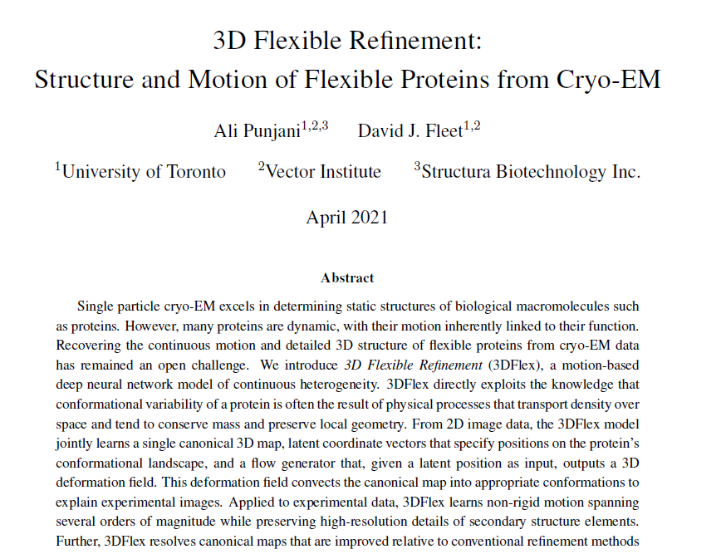

Slide 11
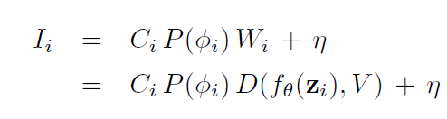
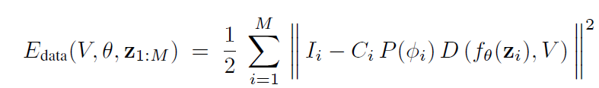
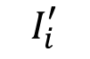
(1) 3DFlex model
Convected density
The model
Learn single canonical 3D map, latent coordinate and flow generator at the same time
$$I_{i}^{′}$$
Additive white noise
Deformation field
Convection operator
Notes:
Central to 3DFlex is the assumption that conformations of a dynamic protein are related to each other through deformation of a single 3D structure.
Deformation field
x is 3D position

Slide 12
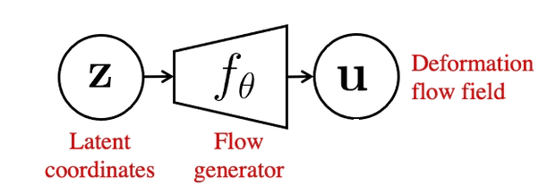
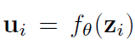
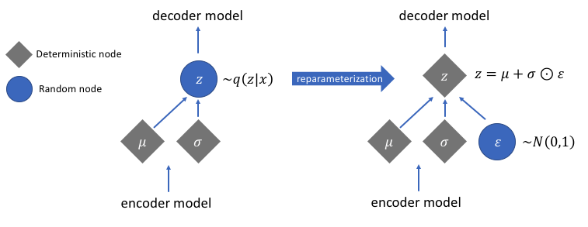
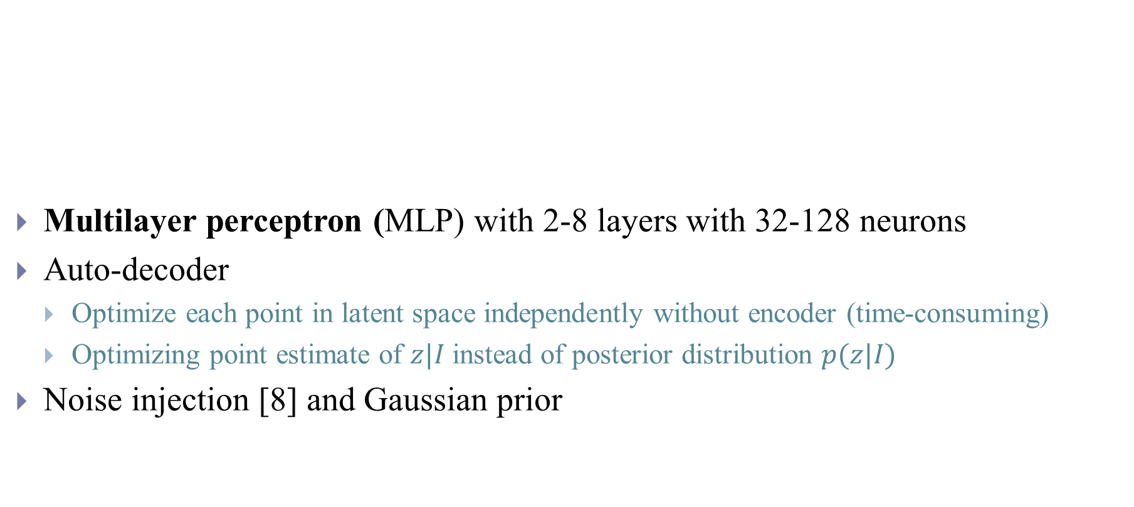
(2) Flow generator
Multilayer perceptron (MLP) with 2-8 layers with 32-128 neurons
Auto-decoder
Optimize each point in latent space independently without encoder (time-consuming)
Optimizing point estimate of $z|I$ instead of posterior distribution $p(z|I)$
Noise injection [8] and Gaussian prior
Notes:
Coordinate descent may be used
The encoder deterministically maps a data point x to mean µφ(x) and variance σφ(x) in the latent space. The input to Dθ is then simply the mean µφ(x) augmented with Gaussian noise scaled by σφ(x) via the reparametrization trick
Hadamard product
Using random noise injection to regularize neural networks is a well-known. It implicitly helps to smooth the function learned by the network at the price of increased variance in the gradients during training. In turn, decoder regularization is a key component in generalization for VAEs
Indeed, from a generative perspective, regularization is motivated by the goal to learn a smooth latent space where similar data points x are mapped to similar latent codes z, and small variations in Z lead to reconstructions by Dθ that vary only slightly
Constant variance VAE

Slide 13
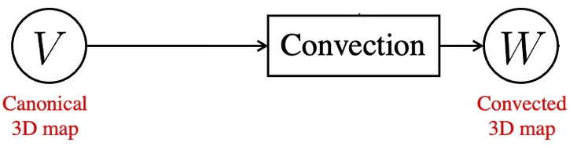
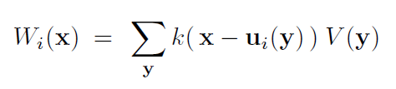
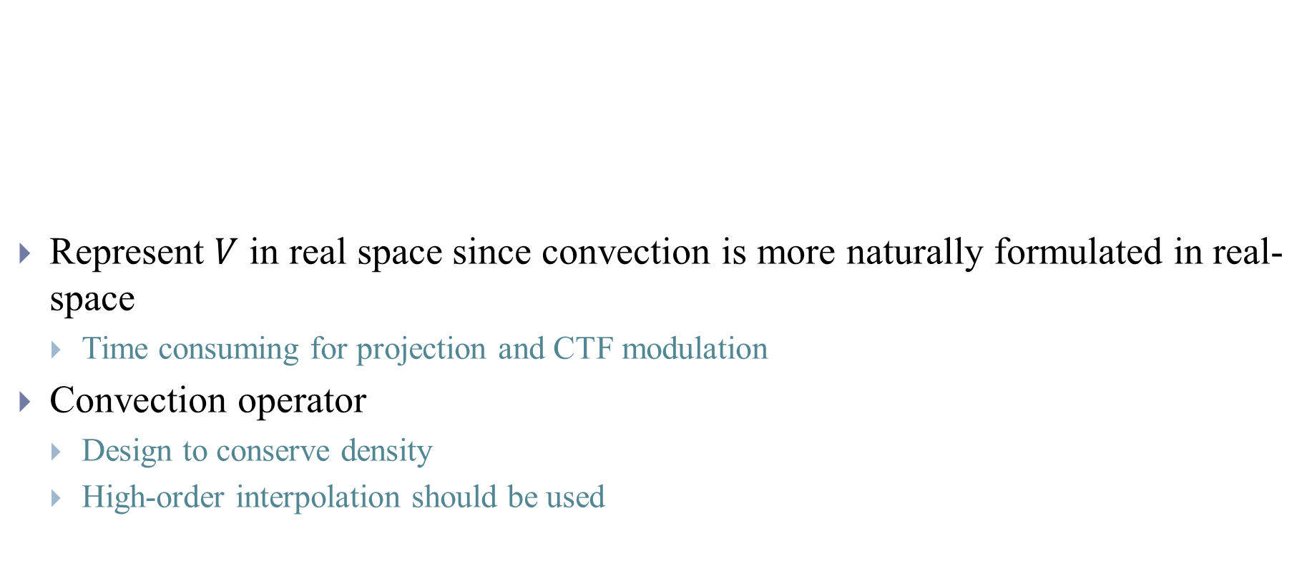
(3) Canonical map and deformation
Represent $V$ in real space since convection is more naturally formulated in real-space
Time consuming for projection and CTF modulation
Convection operator
Design to conserve density
High-order interpolation should be used
Interpolation kernel
Notes:
Canonocal coordinate to deformation coordinate

Slide 14
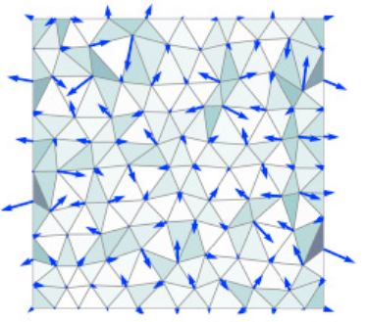
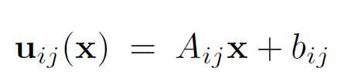
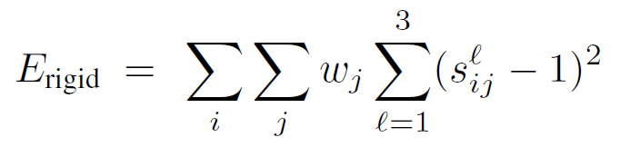
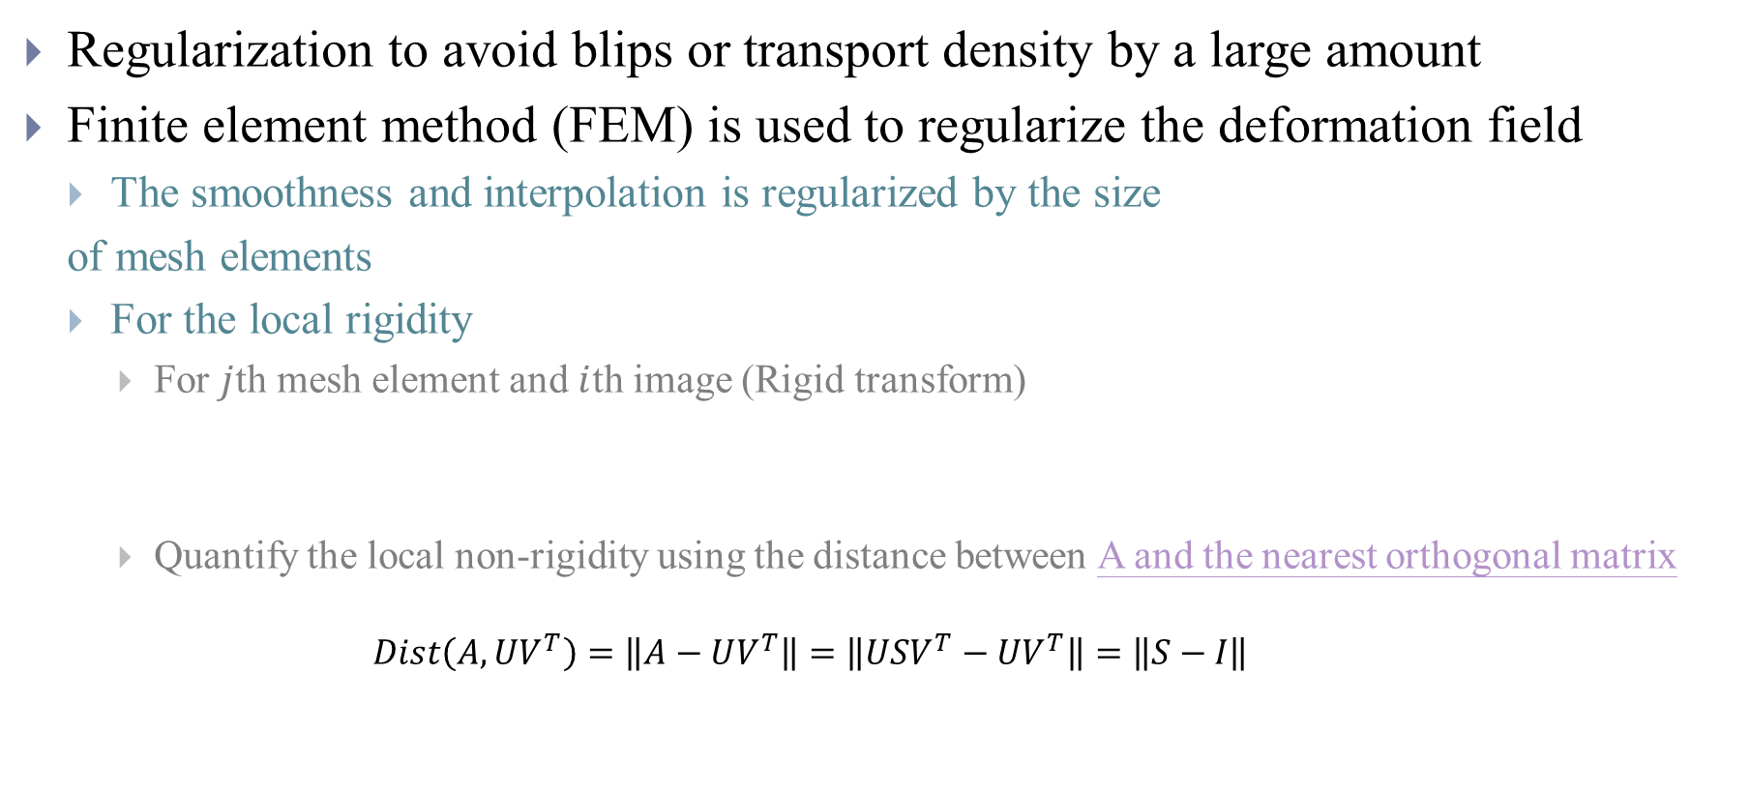
(3) Canonical map and deformation
Regularization to avoid blips or transport density by a large amount
Finite element method (FEM) is used to regularize the deformation field
The smoothness and interpolation is regularized by the size
of mesh elements
For the local rigidity
For $j$th mesh element and $i$th image (Rigid transform)
Quantify the local non-rigidity using the distance between A and the nearest orthogonal matrix
$$Dist\left(A, UV^{T}\right)=\left\|A−UV^{T}\right\|=\left\|USV^{T}−UV^{T}\right\|=\left\|S−I\right\|$$
Density within each element
Notes:
Nanodisc - > Structural noise
Over-fitting also occurs when the regularization is not strong enough to force the model to separate structure from motion. For example, rather than improve the canonical density with structure common to all conformations, the model sometimes learned to deform a low-resolution canonical density to create high-resolution structure (with highly variable local deformations)
In particular, it is unlikely that natural deformations would involve large discontinuities in regions of high density; e.g. an alpha-helix should not be sheared into disjoint pieces. It is also unlikely that deformations will be highly non-rigid at fine scales in regions of high density; at the extreme, bond lengths should not stretch or compress substantially
acting on flow fields defined at each voxel, like limiting the frequency content of the flow field, or penalizing its curvature. However these regularizers were difficult to tune and did not prevent over-fitting reliably
The orthogonal invariance of the Frobenius norm
https://math.stackexchange.com/questions/1477855/distance-of-a-matrix-from-the-orthogonal-group
This weighting ensures that deformation fields are permitted to compress and expand empty space around the protein.

Slide 15
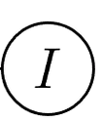
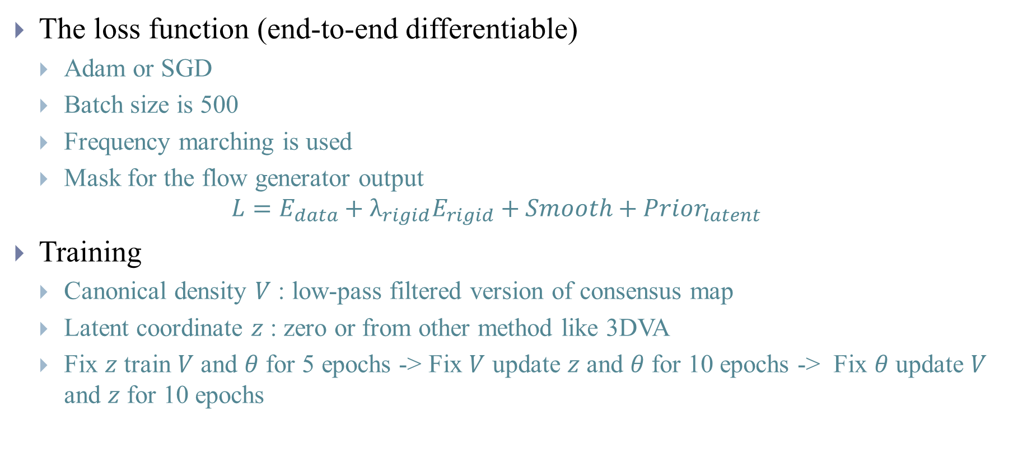
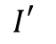
(4) Optimization
The loss function (end-to-end differentiable)
Adam or SGD
Batch size is 500
Frequency marching is used
Mask for the flow generator output
$$L=E_{data}+λ_{rigid}E_{rigid}+Smooth+{Prior}_{latent}$$
Training
Canonical density $V$ : low-pass filtered version of consensus map
Latent coordinate $z$ : zero or from other method like 3DVA
Fix $z$ train $V$ and $θ$ for 5 epochs -> Fix $V$ update $z$ and $θ$ for 10 epochs -> Fix $θ$ update $V$ and $z$ for 10 epochs
$$I_{}^{′}$$

Slide 16
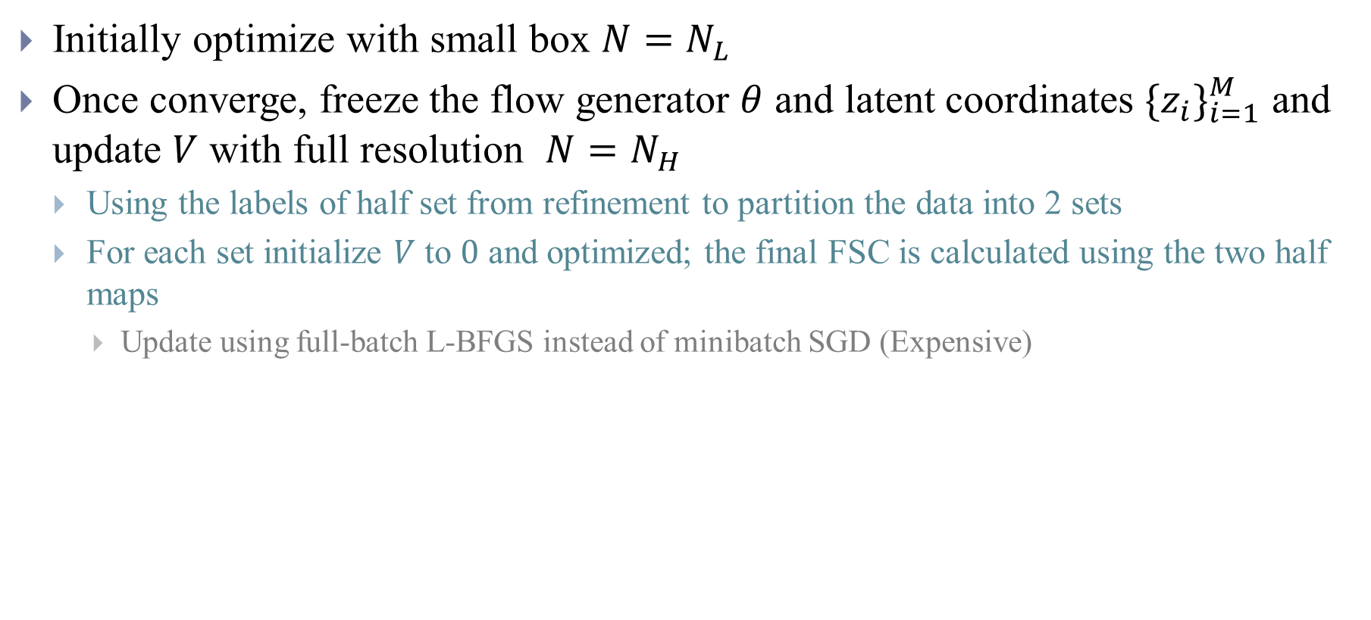
(5) High-resolution refinement
Initially optimize with small box $N=N_{L}$
Once converge, freeze the flow generator $θ$ and latent coordinates ${\{z_{i}\}}_{i=1}^{M}$ and update $V$ with full resolution $N=N_{H}$
Using the labels of half set from refinement to partition the data into 2 sets
For each set initialize $V$ to $0$ and optimized; the final FSC is calculated using the two half maps
Update using full-batch L-BFGS instead of minibatch SGD (Expensive)

Slide 17
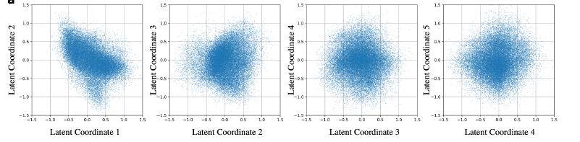
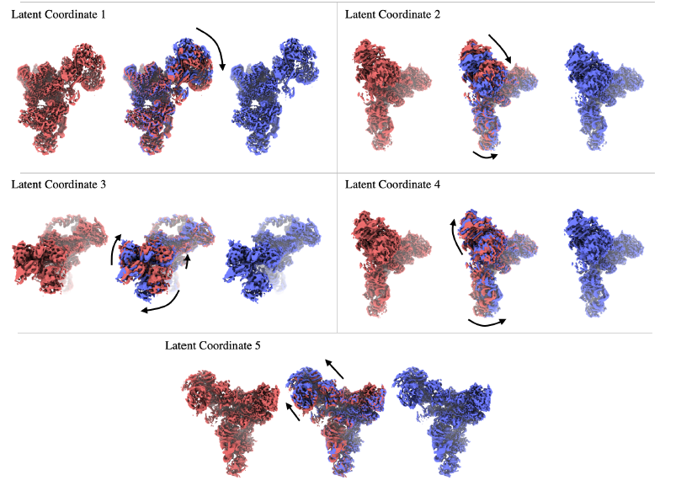
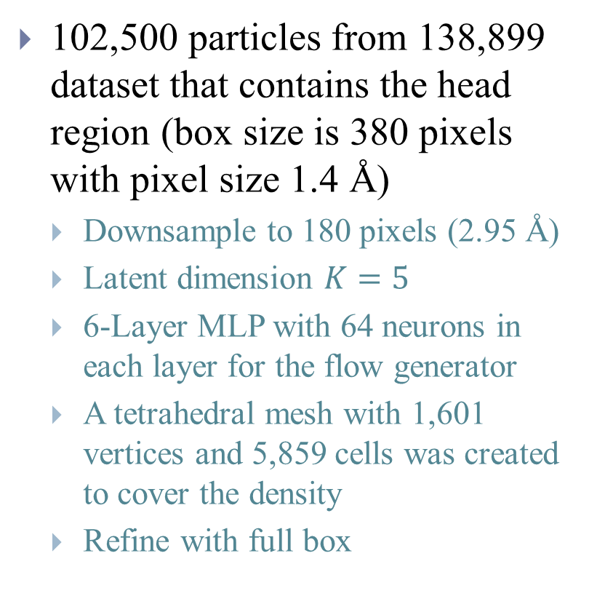
snRNP spliceosome - Large non-rigid deformations of a complex
102,500 particles from 138,899 dataset that contains the head region (box size is 380 pixels with pixel size 1.4 Å)
Downsample to 180 pixels (2.95 Å)
Latent dimension $K=5$
6-Layer MLP with 64 neurons in each layer for the flow generator
A tetrahedral mesh with 1,601 vertices and 5,859 cells was created to cover the density
Refine with full box
Notes:
Convected densities from 3DFlex at minus one (red) and plus one (blue) standard deviations in the latent space, along each of the five latent dimensions.

Slide 18


snRNP spliceosome - Large non-rigid deformations of a complex
Notes:
Top row: An alpha-helix in the head region of the protein that translated by several Angstroms.
Bottom row: A beta-sheet in the head region that translates and deforms.
For example, local resolution in the center of the head region is improved from 5.7°A to 3.8A° . For a complex as large as the snRNP, it is worth noting that one could create manual masks around regions that are expected to be rigid, and then perform local or multibody refinement. Such refinement techniques can improve resolution and map quality in domains like the foot region, which remains rigid despite motion relative to the remainder of the molecule. In contrast, 3DFlex does not require manual masking or prior knowledge about the motion of the molecule. It can detect and then correct for non-rigid flexibility across the entire molecule at once, including the head region, which is considerably less rigid than the foot.

Slide 19






Case Study
https://guide.cryosparc.com/processing-data/tutorials-and-case-studies/tutorial-3d-variability-analysis-part-one
https://guide.cryosparc.com/processing-data/tutorials-and-case-studies/case-study-yeast-u4-u6.u5-tri-snrnp

Slide 20


TRPV1
380 kDa, more than 200,000 particles with box size 224 pixels and 1.21 Å
Downsample to 128 pixels (2.15 Å)
Initialize latent space with 3DVA ($K=2$)
3-Layer MLP with 32 neurons in each layer for the flow generator
Mask is used to mask out the nanodisc region to have zero deformation
Refine with full box

Slide 21


TRPV1
<50kDa
https://cryosparc.com/3dflex

Slide 22

Conclusion
It is easier to represent motion or probe specific region using e2GMM
The memory consumption is large since all Gaussian points have to be represented as images
The motion learned across a protein’s conformation landscape can be used to improve the final map in 3DFlex
Recover motions and structure of non-rigidly deformable parts
Inherent representation of convection that preserves local geometry
$V$ can use other bases other than voxel like neural field [9]
Per voxel flow field and mesh representation can be changed
Compositional variability or rotary can be added to the structure using prior on flow generator
Interpretation of latent space is hard

Slide 23
References
[1] Penczek, Pawel A., Marek Kimmel, and Christian MT Spahn. "Identifying conformational states of macromolecules by eigen-analysis of resampled cryo-EM images." Structure 19.11 (2011): 1582-1590.
[2] Punjani, Ali, and David J. Fleet. "3D Variability Analysis: Resolving continuous flexibility and discrete heterogeneity from single particle cryo-EM." Journal of Structural Biology (2021).
[3] https://franklab.cpmc.columbia.edu/franklab/archives/24187
[4] Zhong, Ellen D., et al. "CryoDRGN: reconstruction of heterogeneous cryo-EM structures using neural networks." Nature Methods 18.2 (2021): 176-185.
[5] Wu, Z., Zhang, S., Wang, W. L., Ma, Y., Dong, Y., & Mao, Y. “Deep manifold learning reveals hidden dynamics of proteasome autoregulation.” arXiv preprint arXiv:2012.12854. (2020).
[6] Chen, Muyuan, and Steven Ludtke. "Deep learning based mixed-dimensional GMM for characterizing variability in CryoEM." arXiv preprint arXiv:2101.10356 (2021).
[7] Punjani, Ali, and David J. Fleet., “3D Flexible Refinement: Structure and Motion of Flexible Proteins from Cryo-EM”, BioRxiv (2021).04.22.440893
[8] Ghosh, P., Sajjadi, M. S., Vergari, A., Black, M., & Schölkopf, B. From variational to deterministic autoencoders. arXiv preprint arXiv:1903.12436. (2019).
[9] Ranno, Nathan, and Dong Si. "Neural Representations of Cryo-EM Maps and a Graph-Based Interpretation." arXiv preprint arXiv:2104.01468 (2021).

